Slide 1

Data Model Design
Jeffery S. Horsburgh
Hydroinformatics
Fall 2016
This work was funded by National Science Foundation Grants EPS 1135482 and EPS 1208732

Slide 2
Announcements
Assignment 3 – Live on Canvas, due next Thursday
Semester project problem statements due next Thursday

Slide 3
Objectives
Identify and describe important entities and relationships to model data
Develop data models to represent, organize, and store data
Design and use relational databases to organize, store, and manipulate data

Slide 4
Data Modeling
Goal – make sure all data objects required by a database are completely and accurately represented
Data model design – the blueprint for creating a physical implementation of a database

Slide 5
Data Model Design
Our focus – relational data model design
Three stages:
Conceptual data model
Logical data model
Physical data model

Slide 6
Logical Data Model
Technology independent
Contains more detail than the Conceptual Data Model
Considered by many to be just an expanded conceptual data model
Defines
Entities AND their attributes
Relationships AND cardinality
Constraints (think Business Rules)
Generally completed as a documented Entity Relationship (ER) Model or diagram

Slide 7
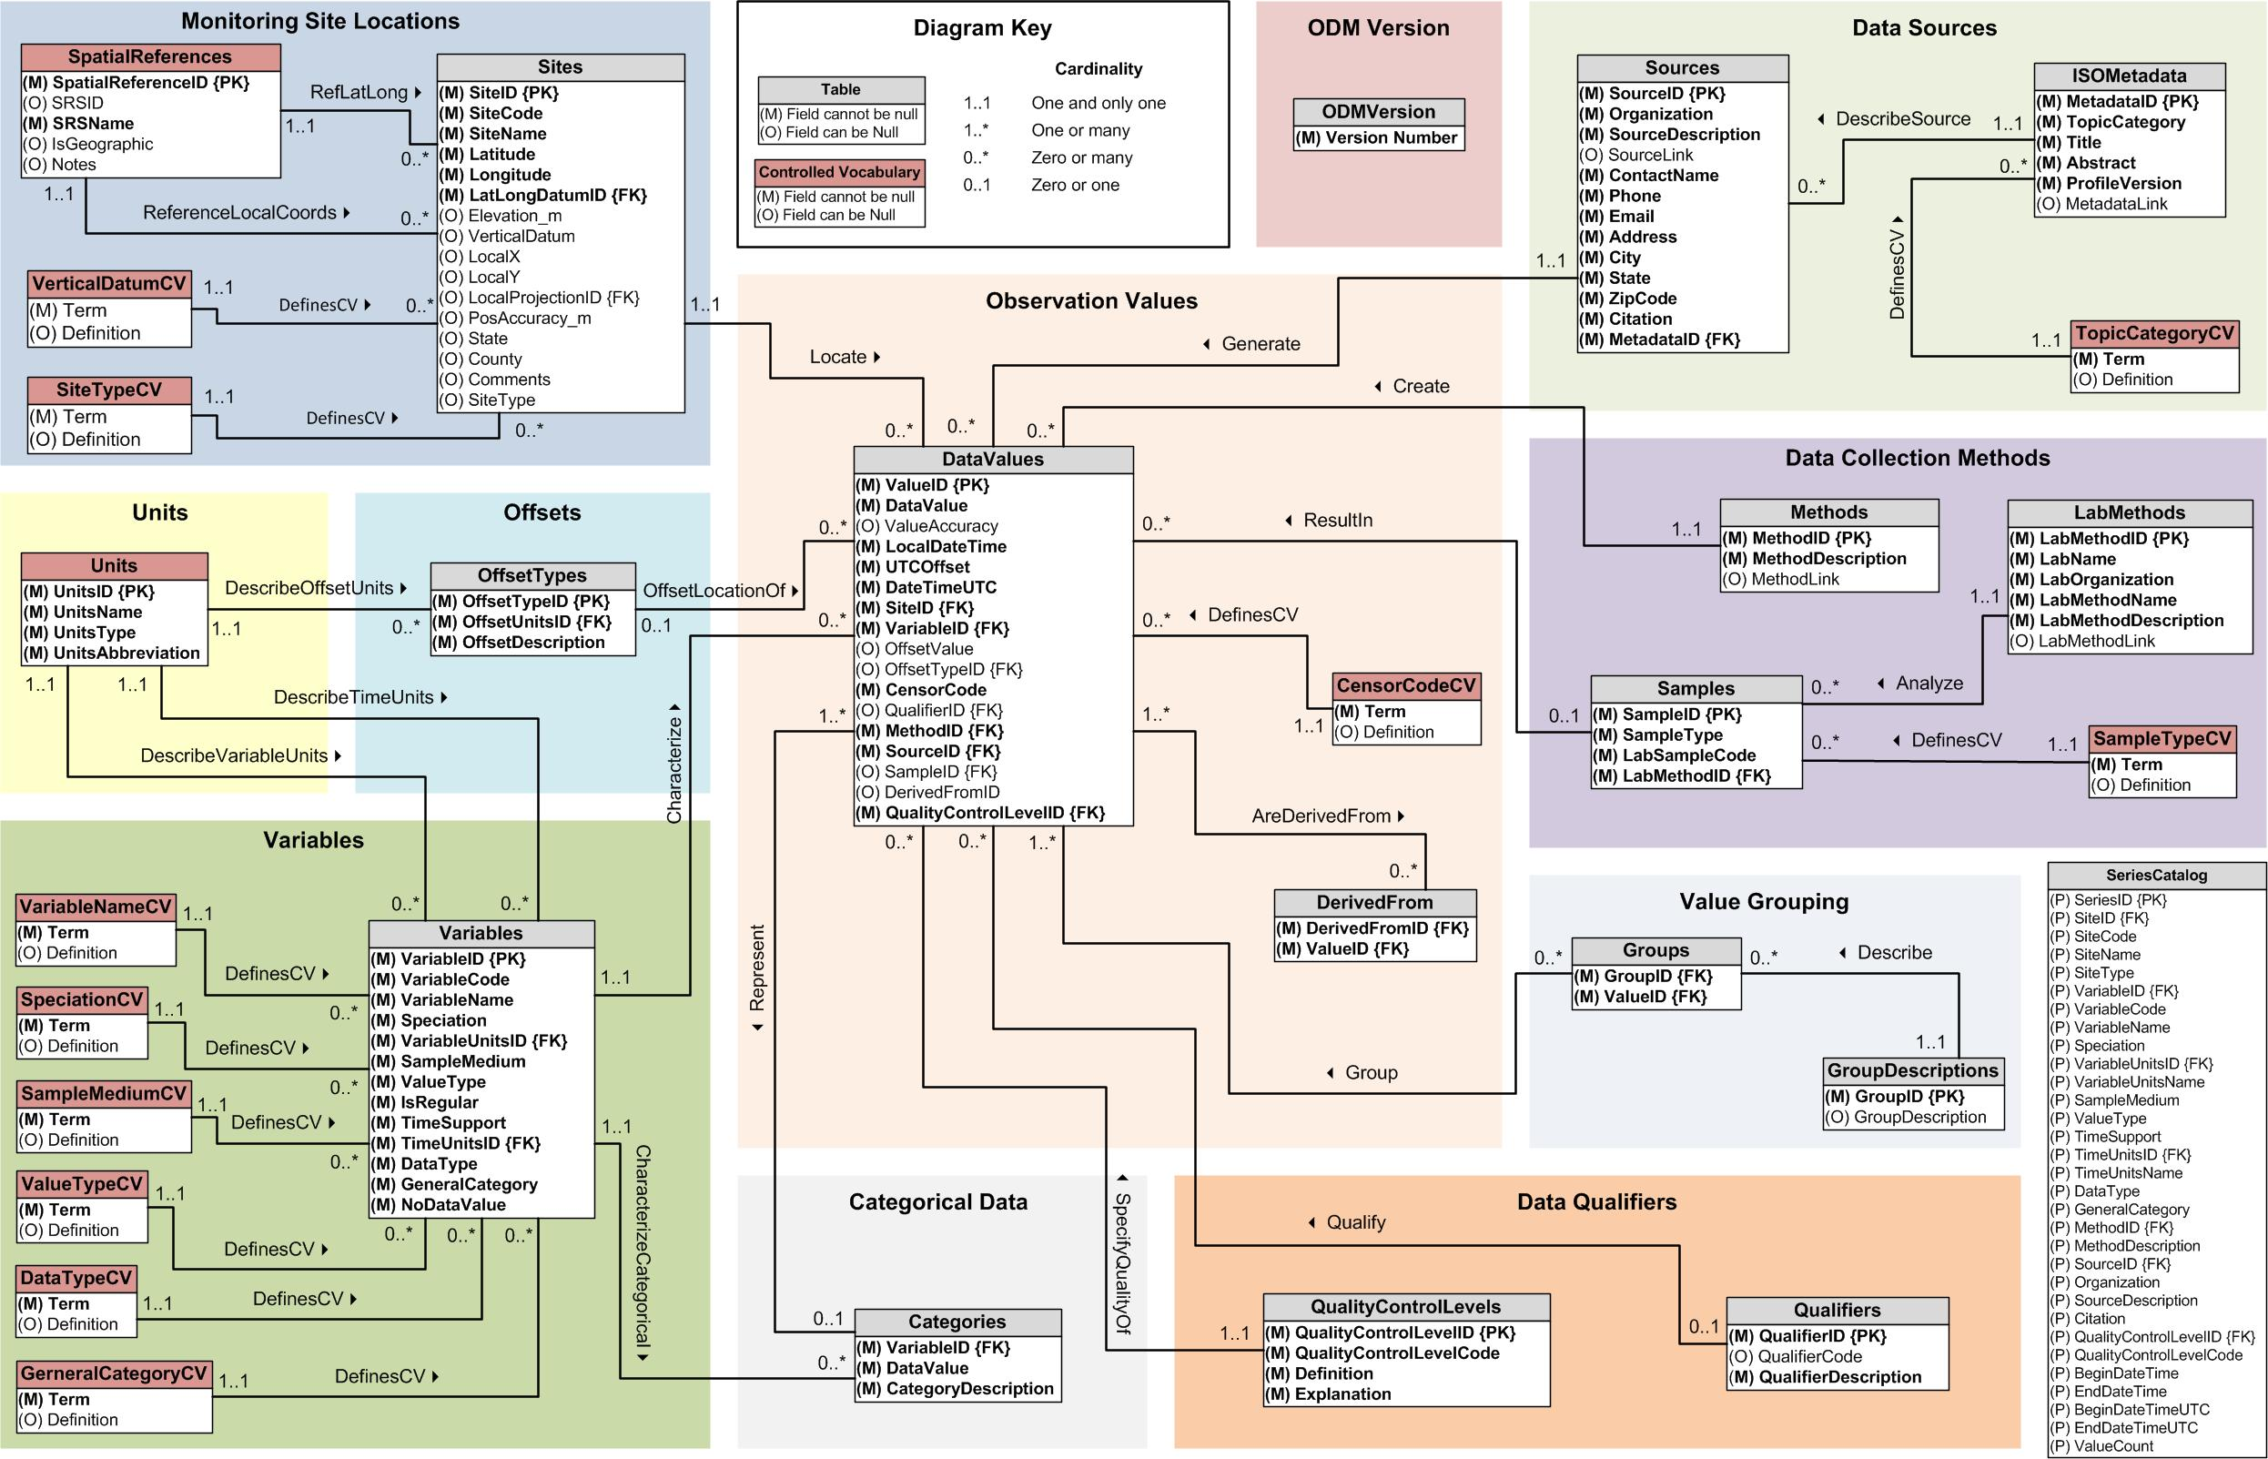
Example: ODM Logical Data Model ER Diagram

Slide 8
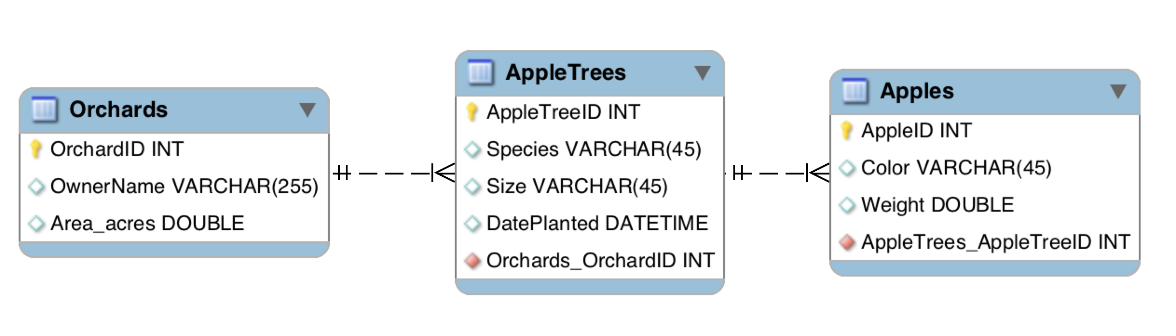
Entity Relationship Diagram
Documentation of the structure of the data
Used to communicate the design
Serve as the basis for data model implementation
Relationship
Entity

Slide 9
Entity Relationship Diagram (Relation Database Context)
Entities effectively become tables
Attributes describe entities and become fields (columns) in tables
Relationships link tables on a common attribute or “key” and become formal constraints (part of the business rules)

Slide 10
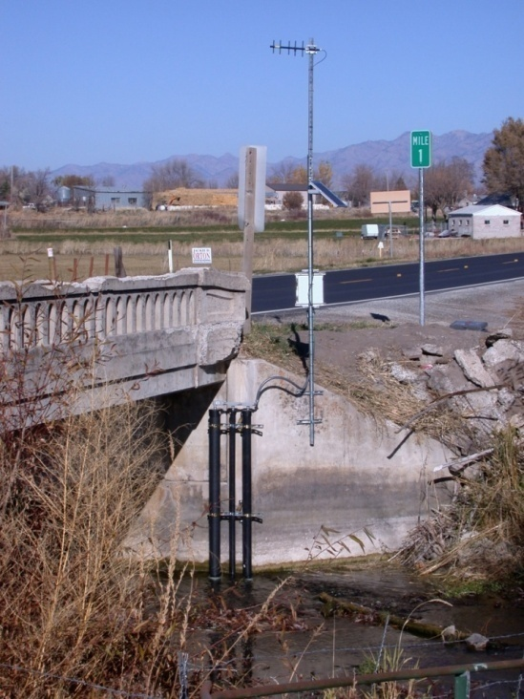
Entities and Attributes
What are the attributes of a monitoring site?
Attributes Values
Site Name: Little Bear River near Wellsville
Site Code: USU-LBR-Wellsville
Latitude: 41.643457
Longitude: -111.917649
Elevation: 1365 m
State: Utah
County: Cache
Description: Attached to SR101 bridge.
Site Type: Stream
Relational Model: All instances of an entity have the same attributes
Entity = Monitoring Site

Slide 11
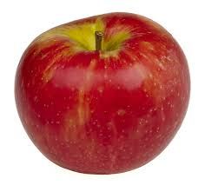
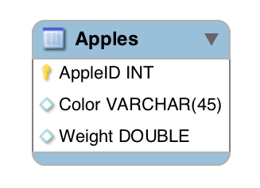
ER Diagram Entity Notation
Entity Name
Data Type
Attributes
Entity

Slide 12
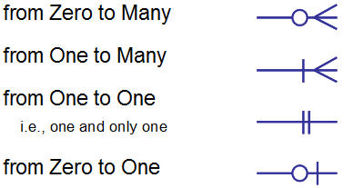
ER Diagram Relationship Notation
Multiple notation systems are used
Each software program is a little different
Most common is “Crows Foot”
Crows Foot
Alternative
0 .. *
1 .. *
1 .. 1
0 .. 1

Slide 13
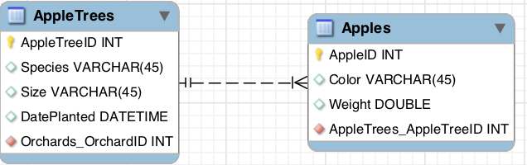
Relationship Cardinality and Participation
Cardinality: maximum number of times an instance in one entity can be associated with instances in the related entity
Participation: minimum number of times an instance in one entity can be associated with instances in the related entity

Slide 14
Cardinality
Maximum number of times an instance of an entity can be associated with instances of a related entity
Can ONLY have values of 1 or many
Located closest to the entity in Crows Foot notation

Slide 15
Participation
Minimum number of times an instance in one entity can be associated with instances in the related entity
Indicates whether an instance of an entity MUST participate in the relationship
Can ONLY have the values of 0 or 1

Slide 16
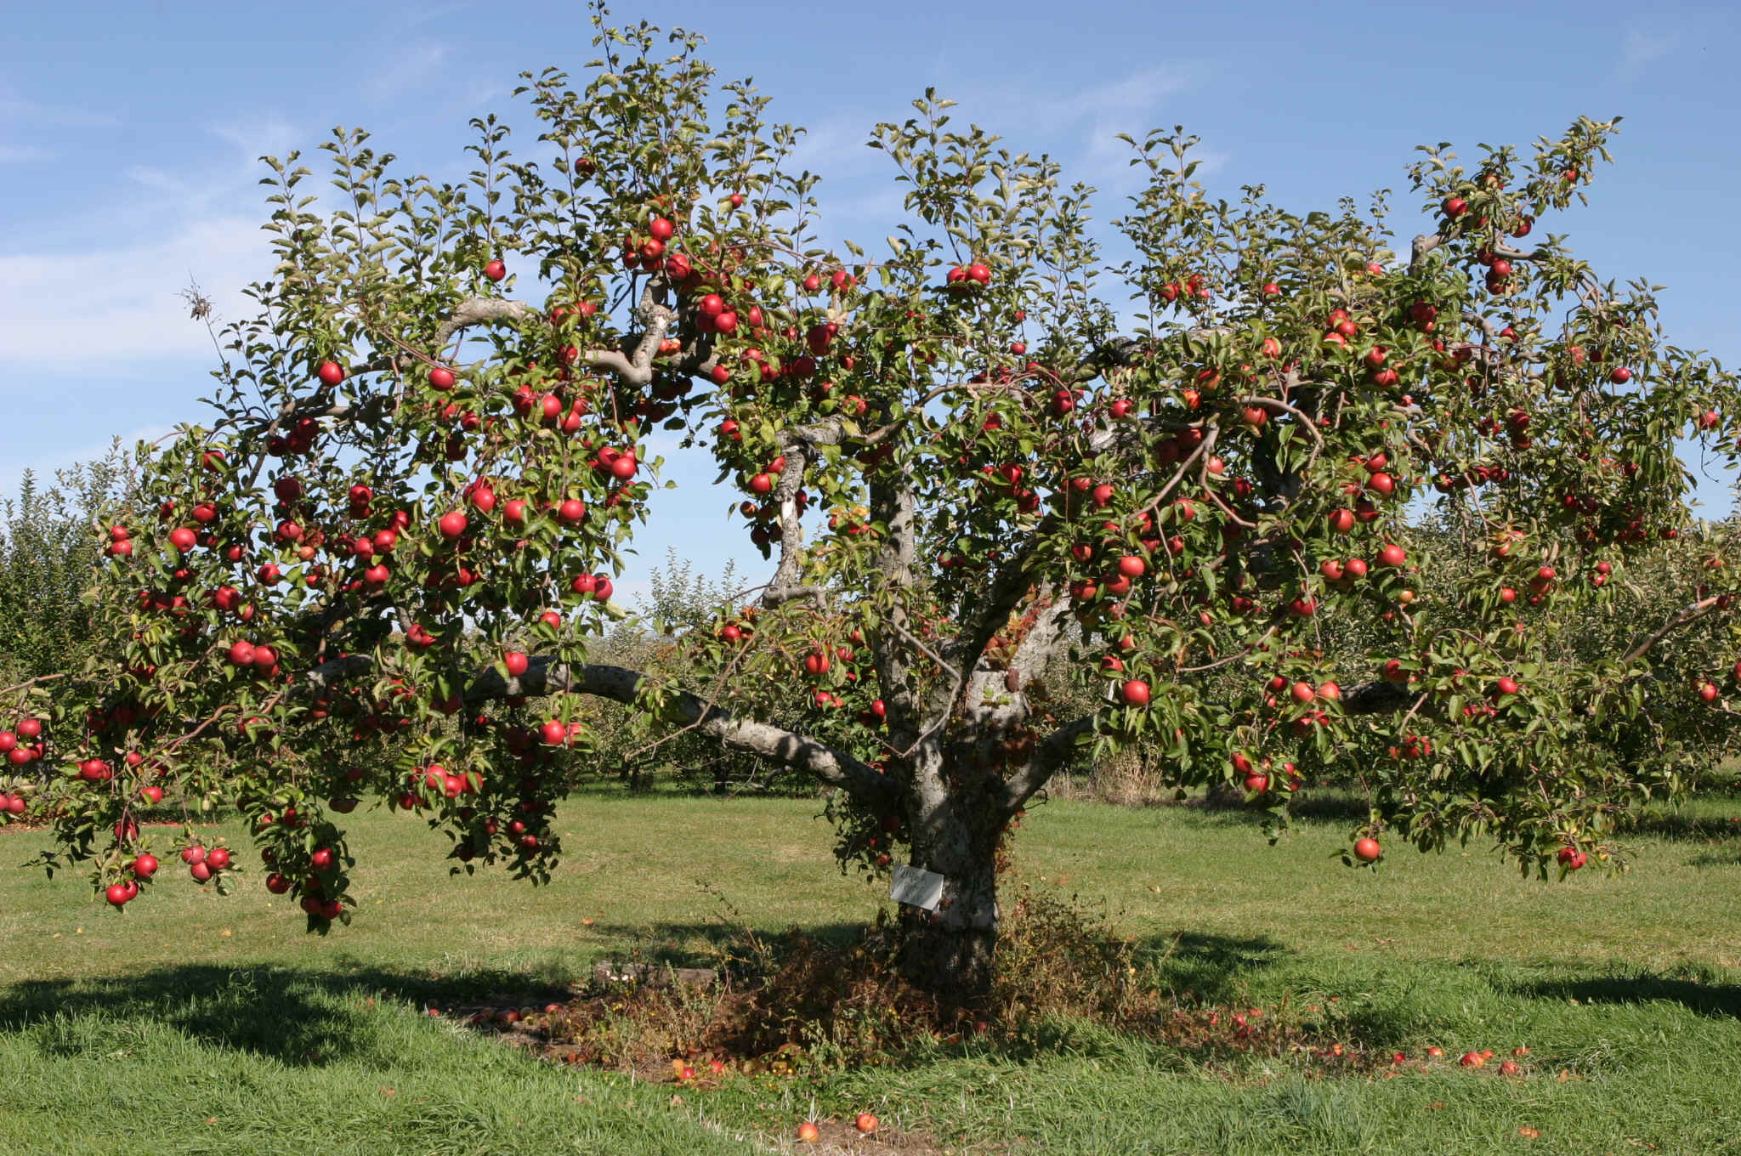
Mapping Cardinality and Participation
Apple
Grows_on
AppleTree
A1
A2
A3
A4
A5
A6
R1
R2
R3
R4
R5
R6
T1
T2
T3

Slide 17
Reading Cardinality and Participation

Slide 18
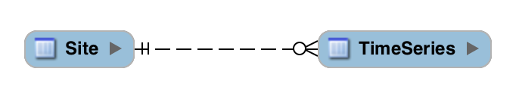
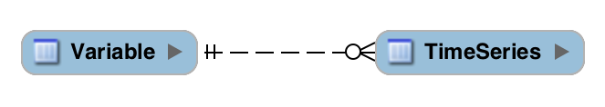
Relationship Examples
Left to Right: A site has 0 or more time series of data.
Right to Left: A time series is measured at 1 and only 1 site.
Left to Right: A variable has 0 or more time series of data.
Right to Left: A time series can have 1 and only 1 variable.

Slide 19
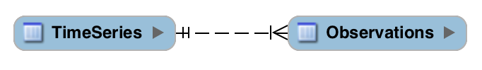
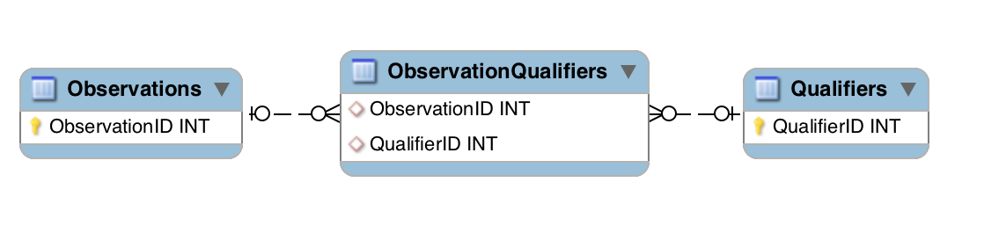
Relationship Examples
Left to Right: A TimeSeries has 1 or more Observations.
Right to Left: An Observation belongs to 1 and only 1 TimeSeries.
Left to Right: An Observation has 0 or more Qualifiers.
Right to Left: A Qualifier describes 0 or more Observations.

Slide 20
Primary and Foreign Keys
Each row in a table should have an attribute that is a persistent, unique identifier – the “Primary Key”
Primary key in “parent” table
Foreign key in “child” table

Slide 21
Primary and Foreign Key Example
OrchardID | OwnerName | Area_acres
1 | John Appleseed | 5.5
2 | Daryl Appleseed | 15
Orchards
AppleTreeID | Species | Size | DatePlanted | OrchardID
1 | Honeycrisp | 5 | 4/15/2010 | 1
2 | Honeycrisp | 6 | 4/15/2010 | 1
3 | Honeycrisp | 3 | 4/15/2010 | 1
Apple
Trees
AppleID | Color | Weight | AppleTreeID
1 | Green | 200 | 2
2 | Green | 180 | 2
3 | Green | 195 | 2
Apples

Slide 22
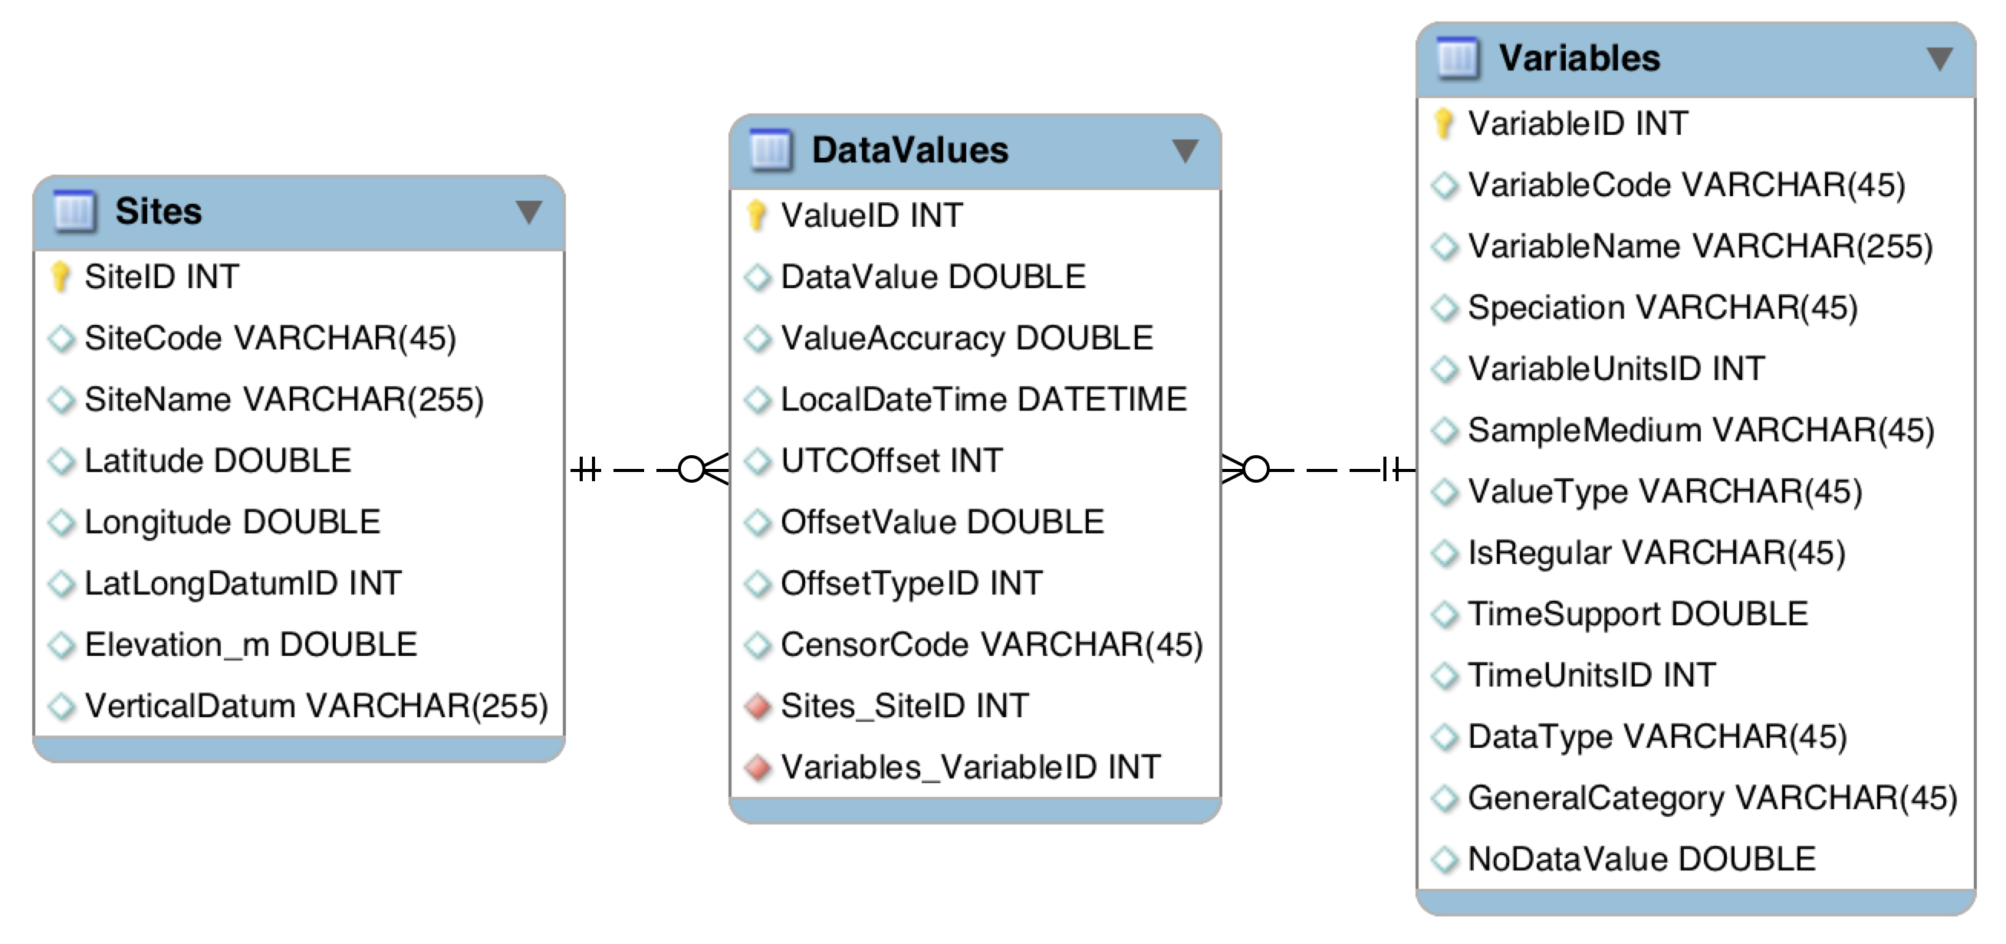
Primary and Foreign Keys
Usually consist of integer values
MUST be the same data type in parent and child tables

Slide 23
What We Have Covered So Far
Steps in Data Model Design
Identify entities
Identify relationships among entities
Determine the cardinality and participation of relationships
Designate keys / identifiers for entities
List attributes of entities
Identify constraints and business rules

Slide 24
Naming Database Objects
Table and attribute names should be
Unique
Have some meaning to the user
Short
No spaces or reserved characters
Entity and Attribute names = nouns
Relationship names = verbs
Many Observations are made at a Site.

Slide 25
More on Attributes
Attribute values should be atomic
Present a single fact
Allows for:
simpler programming
greater reusability of data
easier to implement changes

Slide 26
Atomic Attribute Example
Instead of 1 overloaded attribute:
VariableName = “Dissolved Oxygen, mg/L, surface water”
You might use three:
VariableName = “Dissolved Oxygen”
Units = “mg/L”
SampledMedium = “surface water”

Slide 27
Common Attribute Atomicity Violations
Simple aggregation: Address = “8200 Old Main Hill, Logan, UT, 84322”
Complex codes: VariableCode = “DO_mgL_Avg”
Text fields: Free form text. Overreliance may mean that data requirements may not be met by the model.

Slide 28
Primary Keys
Attribute or set of attributes that uniquely identify a specific instance of an entity (row in the table)
Primary keys must:
Have a non-null value for each instance of an entity
Have a unique value for each instance of an entity
Have values that do not change or become null

Slide 29
Normalization
Organizing the fields and tables in a relational database to minimize redundancy and dependency
Dividing large tables into smaller tables (with relationships)
Isolate data so that additions, deletions, and modifications of a field or record can be made in one place
Reduce the need for restructuring the database as new types of data are introduced

Slide 30
Unnormalized Data Example
SiteID | SiteName | VariableID | VariableName | DateTime | Value
1 | Logan River | 1 | Temperature | 1/1/2012 | 5
1 | Logan River | 1 | Temperature | 1/2/2012 | 5
1 | Logan River | 2 | pH | 1/1/2012 | 8
1 | Logan River | 2 | pH | 1/2/2012 | 8
2 | Spring Creek | 1 | Temperature | 1/1/2012 | 7
2 | Spring Creek | 1 | Temperature | 1/2/2012 | 7
2 | Spring Creek | 2 | pH | 1/1/2012 | 7.5
2 | Spring Creek | 2 | pH | 1/2/2012 | 7.5

Slide 31
Issues with Unnormalized Data
SiteID | SiteName | VariableID | VariableName | DateTime | Value
1 | Logan River | 1 | Temperature | 1/1/2012 | 5
1 | Logan River | 1 | Temperature | 1/2/2012 | 5
1 | Logan River | 2 | pH | 1/1/2012 | 8
1 | Logan River | 2 | pH | 1/2/2012 | 8
INSERT: The fact that a site or variable exists cannot be asserted until a measurement has been loaded into the database.
DELETE: If a row is deleted, information may be lost about not only the measurement, but also the Variable and the Site.
UPDATE: If a SiteName or VariableName changes, multiple records have to be updated with the new information

Slide 32
Normalization Example
1
*
*
SiteID | SiteName
1 | Logan River
2 | Spring Creek
SiteID | VariableID | DateTime | Value
1 | 1 | 1/1/2012 | 5
1 | 1 | 1/2/2012 | 5
1 | 2 | 1/1/2012 | 8
1 | 2 | 1/2/2012 | 8
2 | 1 | 1/1/2012 | 7
2 | 1 | 1/2/2012 | 7
2 | 2 | 1/1/2012 | 7.5
2 | 2 | 1/2/2012 | 7.5
Sites Table
1
VariableID | VariableName
1 | Temperature
2 | pH
Variables Table
DataValues Table

Slide 33
Normalization Tradeoffs
Pros:
Eliminates redundant data
Saves space and can improve storage efficiency
Inserts and updates are done in one place
Can improve efficiency
Cons:
May complicate the code of common queries
Abstracts tables using keys – can be harder for a human to “see” the data

Slide 34

Data Integrity Rules
Entity Integrity
Primary key must exist, be unique, and not null
ValueID | SiteID | VariableID | DateTime | Value
101 | 1 | 1 | 1/1/2012 | 5
102 | 1 | 1 | 1/2/2012 | 5
103 | 1 | 2 | 1/1/2012 | 8
104 | 1 | 2 | 1/2/2012 | 8
105 | 2 | 1 | 1/1/2012 | 7
106 | 2 | 1 | 1/2/2012 | 7
107 | 2 | 2 | 1/1/2012 | 7.5
108 | 2 | 2 | 1/2/2012 | 7.5
SiteID | SiteName
1 | Logan River
2 | Spring Creek
VariableID | VariableName
1 | Temperature
2 | pH

Slide 35
Data Integrity Rules
Referential Integrity
Every foreign key value must match a primary key value in an associated table
Ensures that we can navigate relationships
ValueID | SiteID | VariableID | DateTime | Value
101 | 1 | 1 | 1/1/2012 | 5
102 | 1 | 1 | 1/2/2012 | 5
103 | 1 | 2 | 1/1/2012 | 8
104 | 1 | 2 | 1/2/2012 | 8
105 | 2 | 1 | 1/1/2012 | 7
106 | 2 | 1 | 1/2/2012 | 7
107 | 2 | 2 | 1/1/2012 | 7.5
108 | 2 | 2 | 1/2/2012 | 7.5
SiteID | SiteName
1 | Logan River
2 | Spring Creek
VariableID | VariableName
1 | Temperature
2 | pH

Slide 36
Data Integrity Rules
Insert and Delete Rules
What happens to a parent entity when child entities are deleted?
What happens to child entities when a parent is deleted?
ValueID | SiteID | VariableID | DateTime | Value
101 | 1 | 1 | 1/1/2012 | 5
102 | 1 | 1 | 1/2/2012 | 5
103 | 1 | 2 | 1/1/2012 | 8
104 | 1 | 2 | 1/2/2012 | 8
105 | 2 | 1 | 1/1/2012 | 7
106 | 2 | 1 | 1/2/2012 | 7
107 | 2 | 2 | 1/1/2012 | 7.5
108 | 2 | 2 | 1/2/2012 | 7.5
SiteID | SiteName
1 | Logan River
2 | Spring Creek
VariableID | VariableName
1 | Temperature
2 | pH

Slide 37
Data Integrity Rules
Value Domains
Valid set of values for an attribute
Controlled vocabulary, data type, length, range, constraints, default value
Integer Fields
Date Field
Double
Controlled Domain
ValueID | SiteID | VariableID | DateTime | Value
101 | 1 | 1 | 1/1/2012 | 5.5
102 | 1 | 1 | 1/2/2012 | 5.678
103 | 1 | 2 | 1/1/2012 | 8.0
104 | 1 | 2 | 1/2/2012 | 8.9
VariableID | VariableName
1 | Temperature
2 | pH

Slide 38
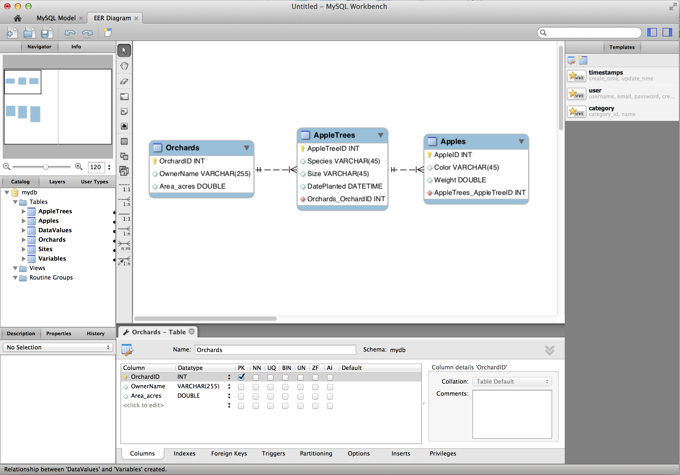
DEMO: Creating an ER Diagram Using MySQL Workbench

Slide 39
Summary
Data model design is a 3 step process – conceptual, logical, physical (future topic)
Conceptual and logical data models can be expressed using Entity Relationship (ER) diagrams
ER diagrams capture the entities, attributes, and relationships to model your information domain
ER diagrams are a powerful way to document the design of your data model

Slide 40
Steps in Data Model Design
Identify entities
Identify relationships among entities
Determine the cardinality and participation of relationships
Designate keys / identifiers for entities
List attributes of entities
Identify constraints and business rules

Slide 41
Exercise
Work alone or in groups of 2-3
Use MySQL Workbench to begin creating an Entity Relationship diagram
Identify entities
Specify attributes
Create relationships

Slide 42
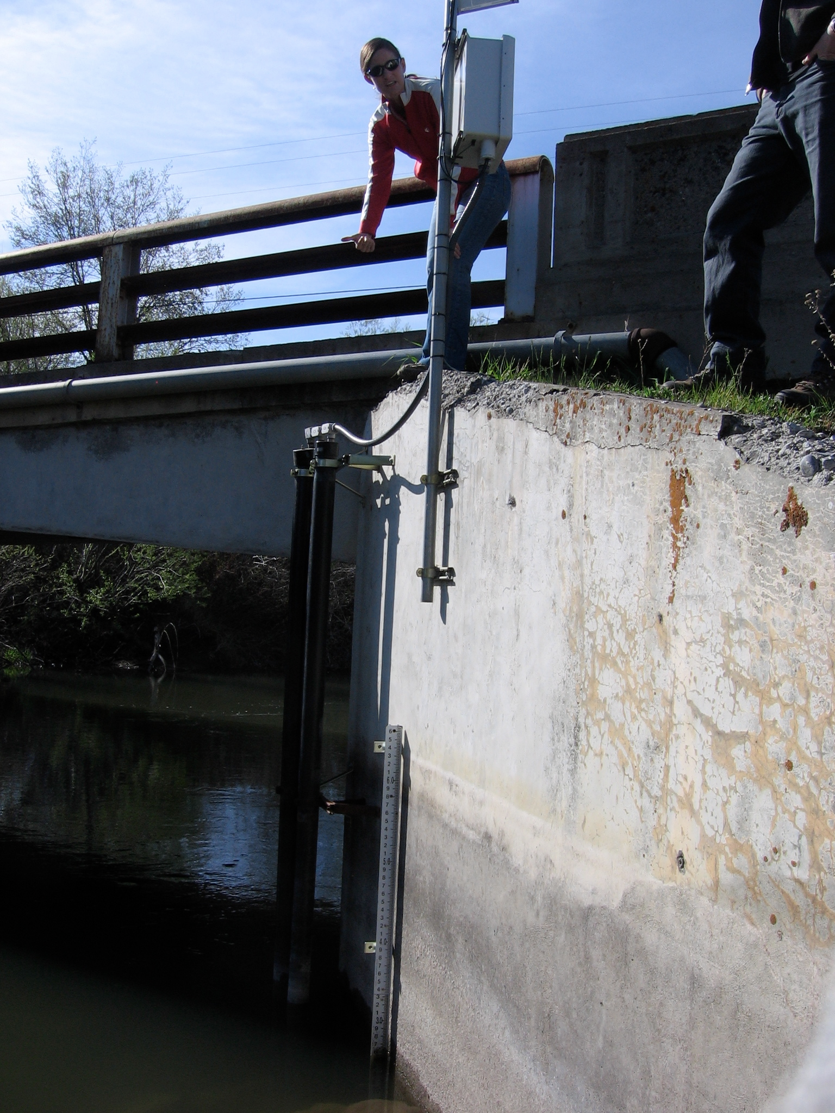
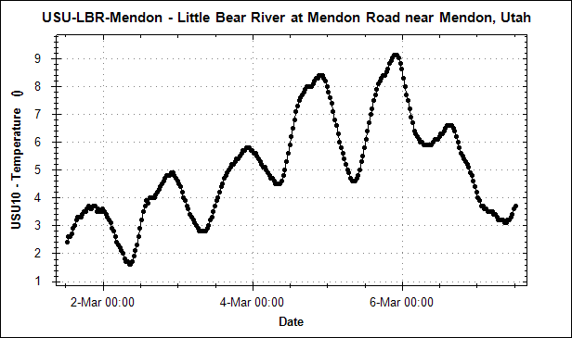
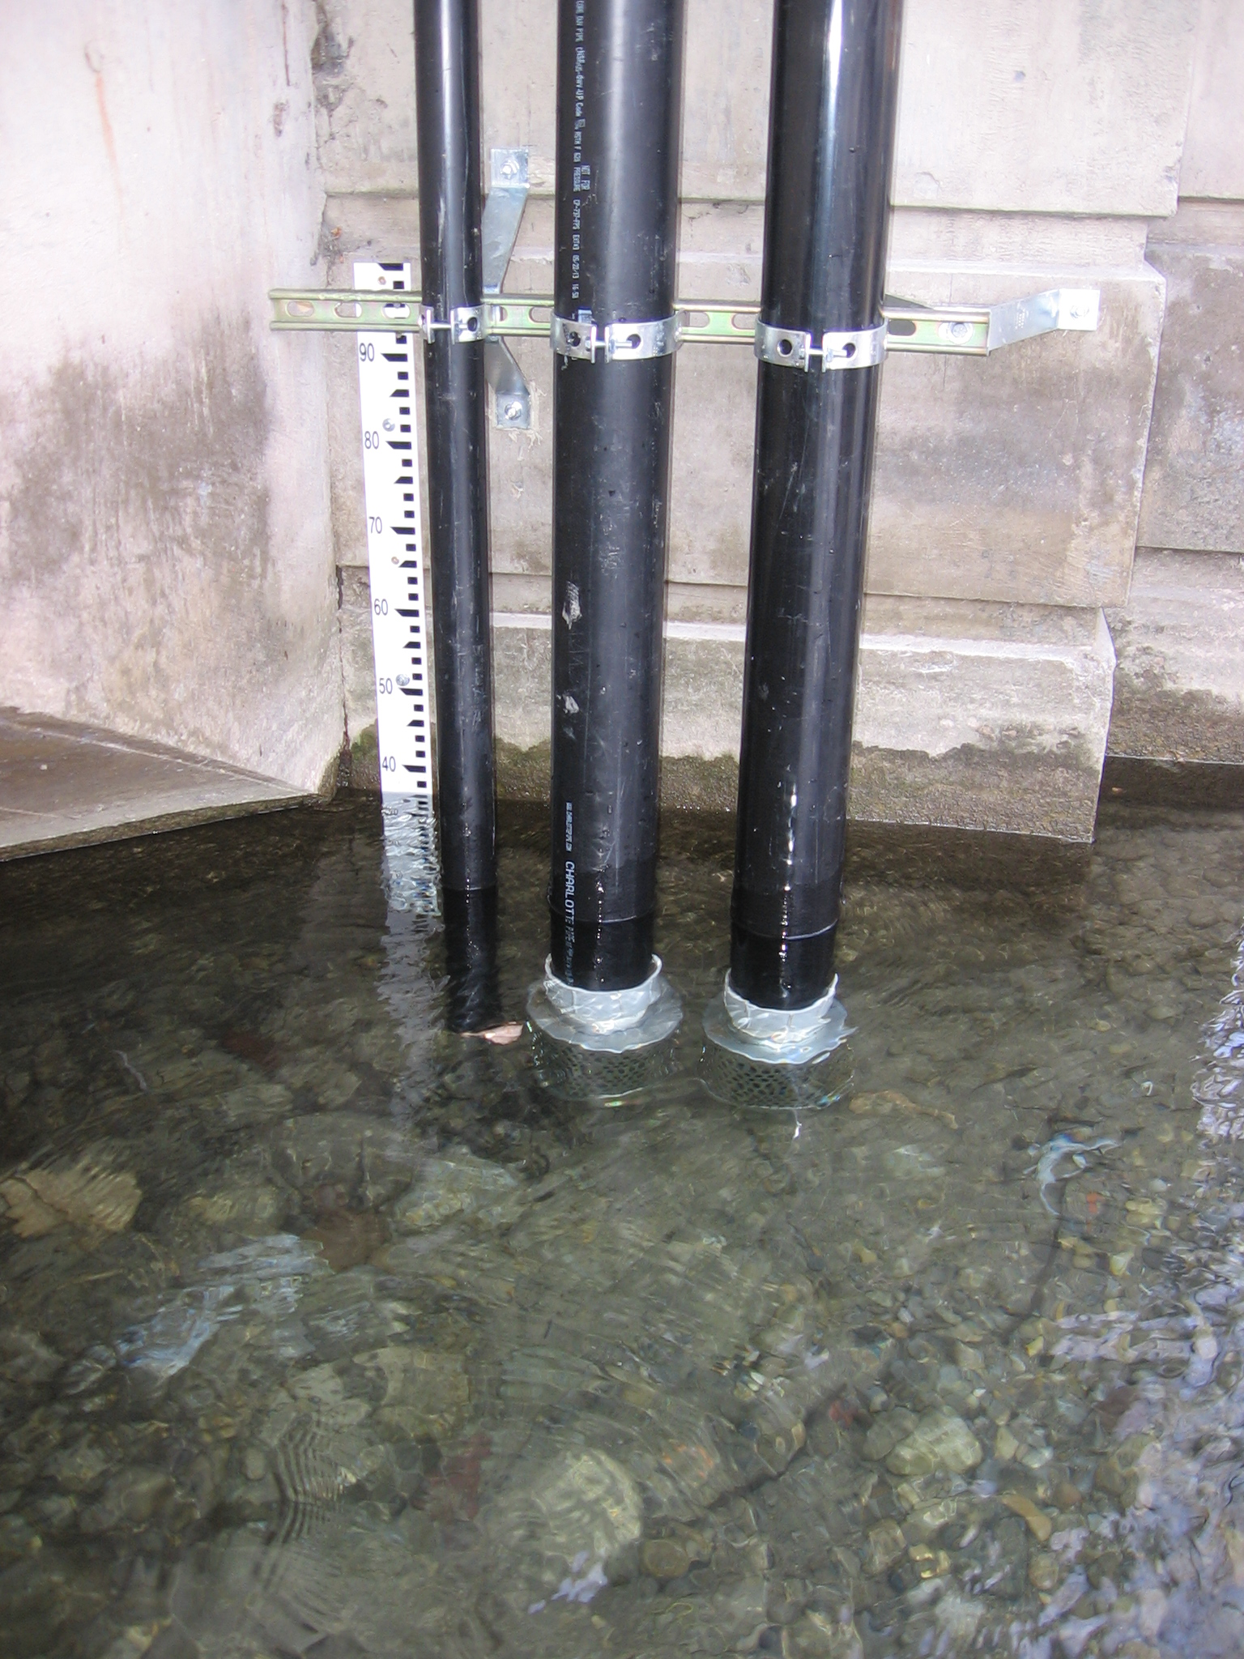
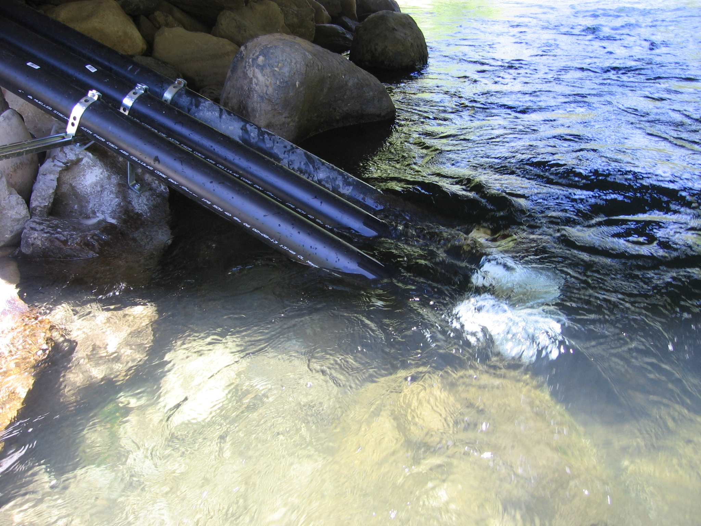

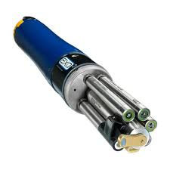

Assignment 3 Data
Multiple Monitoring Sites
1 or More Time Series Per Sensor
3 Different Watersheds
Multiple Sensors at Each Site

